Slide 1

Chapter 11 - Object-Oriented Programming
1-<number>

Slide 2
Object-Oriented Programming
Full support for abstract data types
Encapsulation
Inheritance
  Inheritance is the central theme in OOP
Polymorphism
1-<number>

Slide 3

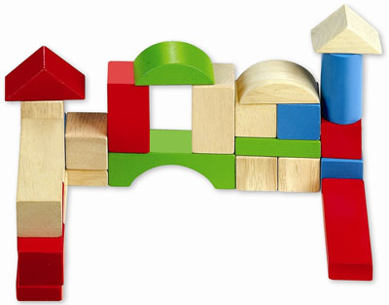
The ultimate goal
M o d u l a r i z a t i o n
Teamwork
Localization of modifiations
Reuse of code & design
Easier testing & debugging
1-<number>

Slide 4
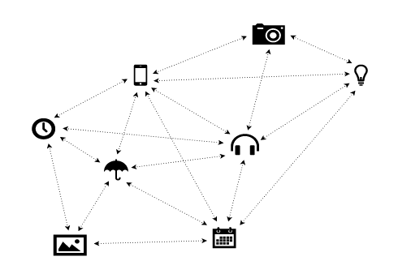
An object-oriented program is a network of objects.
Objects send messages to each other through the edges of this network.
1-<number>

Slide 5
Object-Oriented Concepts (1)
Abstract data types called classes
Class instances called objects
A class that inherits is a subclass (also called derived class ).
The class from which another class inherits is a superclass (also called a parent class).
Subprograms that define operations on objects are called methods
1-<number>

Slide 6
Object-Oriented Concepts (2)
Calls to methods are called messages
The entire collection of methods of an object is called its message protocol or message interface
Messages have two parts--a method name and the destination object
In the simplest case, a class inherits all of the entities of its parent
1-<number>

Slide 7

Inheritance
Manual employment of Abstract data types (abstract data structures) are messy in terms of reuse!
On the other hand:
Inheritance allows new classes defined in terms of existing ones, i.e., by allowing them to inherit common parts
Inheritance allows to reuse ADTs in a class hierarchy
Single vs. Multiple Inheritance ?
1-<number>

Slide 8

Access controls to encapsulated entities:
  A class can hide entities from its subclasses
  A class can hide entities from its clients
  A class can also hide entities from its clients while allowing its subclasses to see them
1-<number>

Slide 9

Overriding
Besides inheriting methods as is, a class can modify an inherited method
  The new one overrides the inherited one
1-<number>

Slide 10
Object-Oriented Concepts (4)
There are two kinds of variables in a class:
  Class variables – one copy for the class
  Instance variables - one/object, store the object’s state.
1-<number>

Slide 11
Polymorphism and Dynamic Binding
The dynamic binding of messages to method definitions enable polymorphism.
Collaborates with inheritance and dynamic binding.
The concept of polymorphism enables to use a definition with various data types.
  To apply a method to different objects (polymorphic function).
1-<number>

Slide 12
Dynamic Binding Concepts
In an inheritance hierarchy, there may be a class that is so high in the hierarchy that an instantiation of the class would not make sense. For ex;furniture, table, desk etc.
An abstract method is one that does not include a definition (it only defines a protocol)
An abstract class is one that includes at least one abstract(virtual) method
An abstract class cannot be instantiated
1-<number>

Slide 13
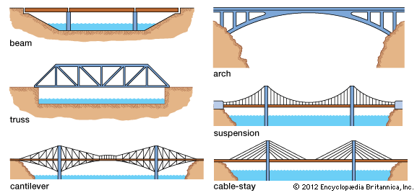
Abstract Concepts are Common
1-<number>

Slide 14
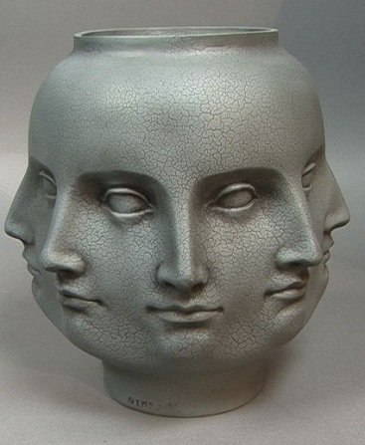
Polymorphism
Polymorphism can be:
  Universal
  Ad hoc
Universal polymorphism means that the functions execute in the same way for all types. It is the real polymorphism.
Ad hoc polymorphism shows the functions that can work with several types. In this case, the function can show different behavior for different types.
1-<number>

Slide 15
Polymorphism
Universal polymorphic functions can;
  Execute the same code for all arguments.
Ad hoc polymorphic functions;
  Execute a different code for different argument types.
1-<number>

Slide 16
Polymorphism
Ad hoc polymorphism can be:
  Overloading
  Coercion
Method overloading: To represent several methods with the same name.
  int hesap( int a)
  {
  return a * 100 ;
  }
  double hesap (double b)
  {
  return b * 100;
  }
1-<number>

Slide 17
Polymorphism – ad hoc
The difference is provided by the data types.
  +, is an ad hoc polymorphic function.
  It shows both float addition and integer addition.
It is not required to have methods that are semantically similar.
1-<number>

Slide 18
Polymorphism
Coercion converts an argument to a type that the function expects. Therefore, the function is valid for only one type, but the argument changes as required.
1-<number>

Slide 19
Polymorphism
Universal polymorphism can be;
  Inclusion polymorphism
  Parametric polymorphism
Inclusion polymorphism is related to subtyping. It means that a function can be applied to a type and its subtype.
In parametric polymorphism, a function can be applied to different types in each execution. For ex; ML functions.
Parametric polymporphism is pure polymorphism.
1-<number>

Slide 20
The Exclusivity of Objects
Everything is an object
Add objects to a complete typing system
Primitives are not objects but make everything else objects
1-<number>

Slide 21
Single or Multiple Inheritance
Multiple inheritance allows a new class to inherit from two or more classes
Disadvantages of multiple inheritance:
  Language and implementation complexity (in part due to name collisions)
  Potential inefficiency - dynamic binding costs more with multiple inheritance (but not much)
Advantage:
  Sometimes it is extremely convenient and valuable
1-<number>

Slide 22
Dynamic and Static Binding
Should all binding of messages to methods be dynamic?
  If none are, you lose the advantages of dynamic binding
  If all are, it is inefficient
    Choose the correct method at run-time
    Validate the parameters & return type at run-time
Allow the programmer to specify
1-<number>

Slide 23

Support for OOP in Smalltalk
A pure OOP language
  Everything is an object
  All objects have local memory
  All computation is through objects sending messages to objects
  None of the appearances of imperative languages
  All objects are allocated from the heap
  All de-allocation is implicit
1-<number>

Slide 24
Support for OOP in Smalltalk (continued)
Type Checking and Polymorphism
  All binding of messages to methods is dynamic
    The process is to search the object to which the message is sent for the method; if not found, search the superclass, etc. up to the system class which has no superclass
  The only type checking in Smalltalk is dynamic and the only type error occurs when a message is sent to an object that has no matching method
1-<number>

Slide 25
Support for OOP in Smalltalk (continued)
Inheritance
  A Smalltalk subclass inherits all of the instance variables, instance methods, and class methods of its superclass
  All subclasses are subtypes (nothing can be hidden)
  No multiple inheritance
1-<number>

Slide 26

Support for OOP in C++
General Characteristics:
  Evolved from SIMULA 67
  Most widely used OOP language
  Mixed typing system
  Constructors and destructors
  Elaborate access controls to class entities
1-<number>

Slide 27
Support for OOP in C++ (continued)
Inheritance
  A class need not be the subclass of any class
  Access controls for members are
    Private (visible only in the class and friends) (disallows subclasses from being subtypes)
    Public (visible in subclasses and clients)
    Protected (visible in the class and in subclasses, but not clients)
1-<number>

Slide 28
Support for OOP in C++ (continued)
In addition, the subclassing process can be declared with access controls (private or public), which define potential changes in access by subclasses
  Private derivation - inherited public and protected members are private in the subclasses
  Public derivation public and protected members are also public and protected in subclasses
1-<number>

Slide 29
Inheritance Example in C++
class base_class {
private:
int a;
float x;
protected:
int b;
float y;
public:
int c;
float z;
};
class subclass_1 : public base_class { … };
// In this one, b and y are protected and
// c and z are public
class subclass_2 : private base_class { … };
// In this one, b, y, c, and z are private,
// and no derived class has access to any
// member of base_class
1-<number>

Slide 30
Support for OOP in C++ (continued)
Multiple inheritance is supported
  If there are two inherited members with the same name, they can both be referenced using the scope resolution operator
1-<number>

Slide 31
Support for OOP in C++ (continued)
Dynamic Binding
  A method can be defined to be virtual, which means that they can be called through polymorphic variables and dynamically bound to messages
  A pure virtual function has no definition at all
  A class that has at least one pure virtual function is an abstract class
1-<number>

Slide 32
Support for OOP in C++ (continued)
  C++ provides extensive access controls (unlike Smalltalk)
  C++ provides multiple inheritance
  In C++, the programmer must decide at design time which methods will be statically bound and which must be dynamically bound
    Static binding is faster!
  Because of interpretation and dynamic binding, Smalltalk is ~10 times slower than C++
1-<number>

Slide 33

Support for OOP in Java
General Characteristics
  All data are objects except the primitive types
  All primitive types have wrapper classes that store one data value
  All objects are heap-dynamic, are referenced through reference variables, and most are allocated with new
  A finalize method is implicitly called when the garbage collector is about to reclaim the storage occupied by the object
1-<number>

Slide 34
Support for OOP in Java (continued)
Inheritance
  Single inheritance supported only, but there is an abstract class category that provides some of the benefits of multiple inheritance (interface)
  An interface can include only method declarations and named constants, e.g.,
  public interface Comparable {
  public int comparedTo (Object b);
  }
  Methods can be final (cannot be overriden)
1-<number>

Slide 35
Support for OOP in Java (continued)
Dynamic Binding
  In Java, all messages are dynamically bound to methods, unless the method is final (i.e., it cannot be overriden, therefore dynamic binding serves no purpose)
  Static binding is also used if the methods is static or private both of which disallow overriding
1-<number>

Slide 36
Support for OOP in Java (continued)
Evaluation
  Design decisions to support OOP are similar to those of C++
  No support for procedural programming
  No parentless classes
  Dynamic binding is used as “normal” way to bind method calls to method definitions
  Uses interfaces to provide a simple form of support for multiple inheritance
1-<number>

